Slide 1
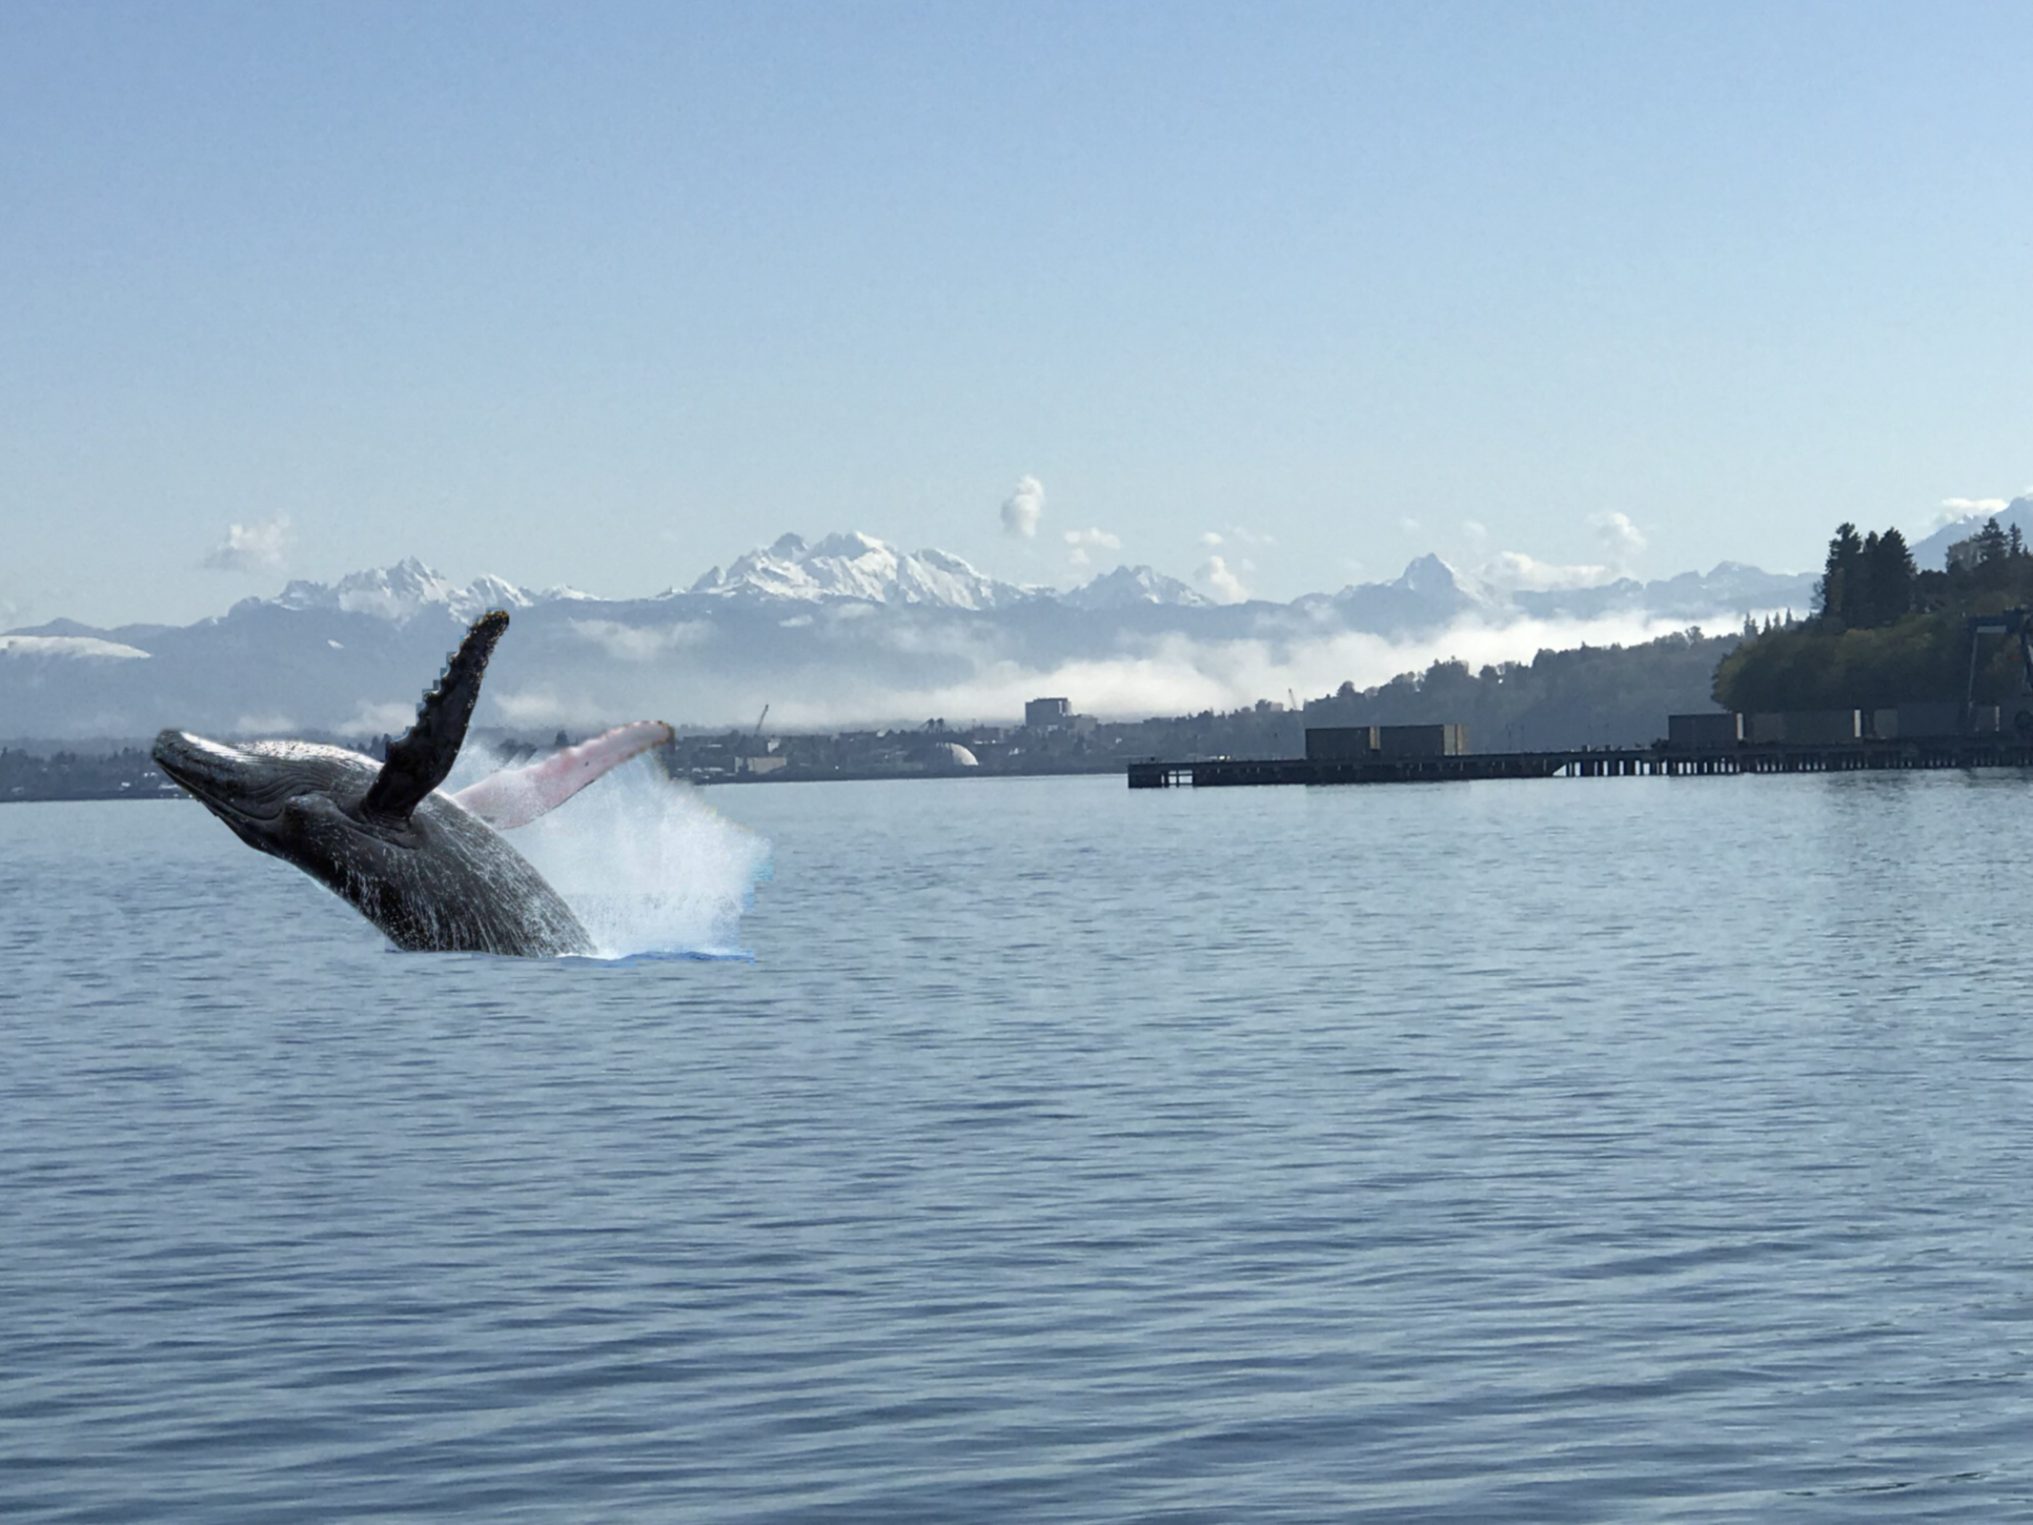
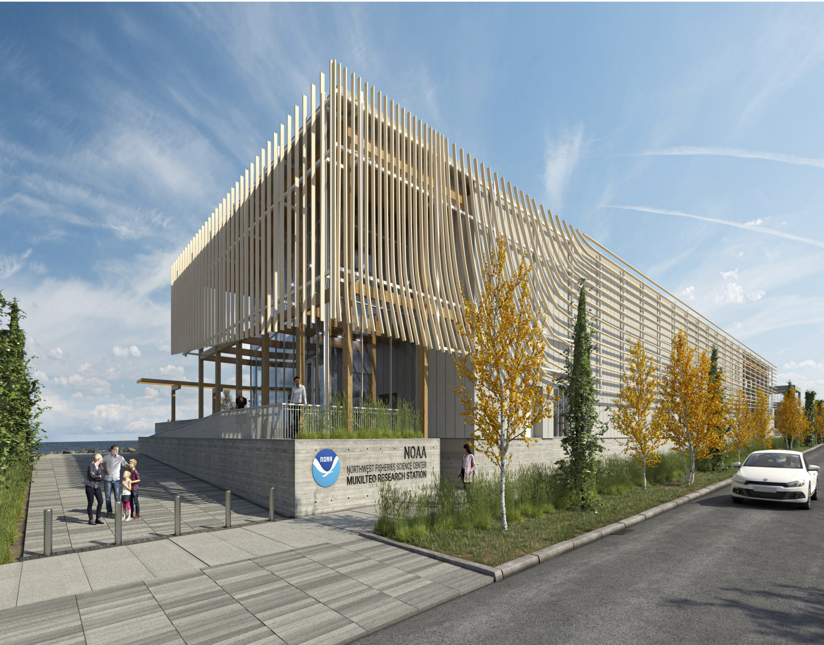
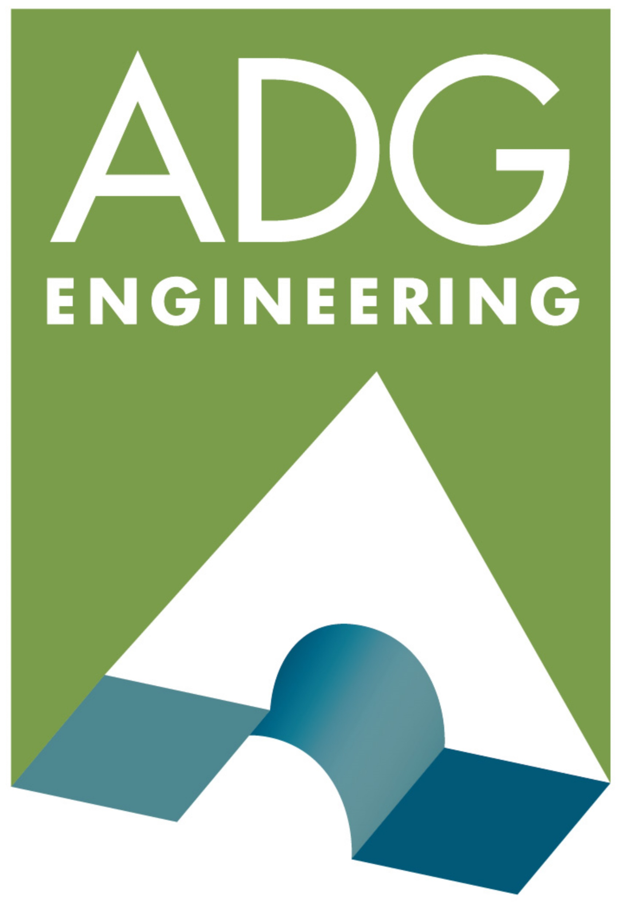
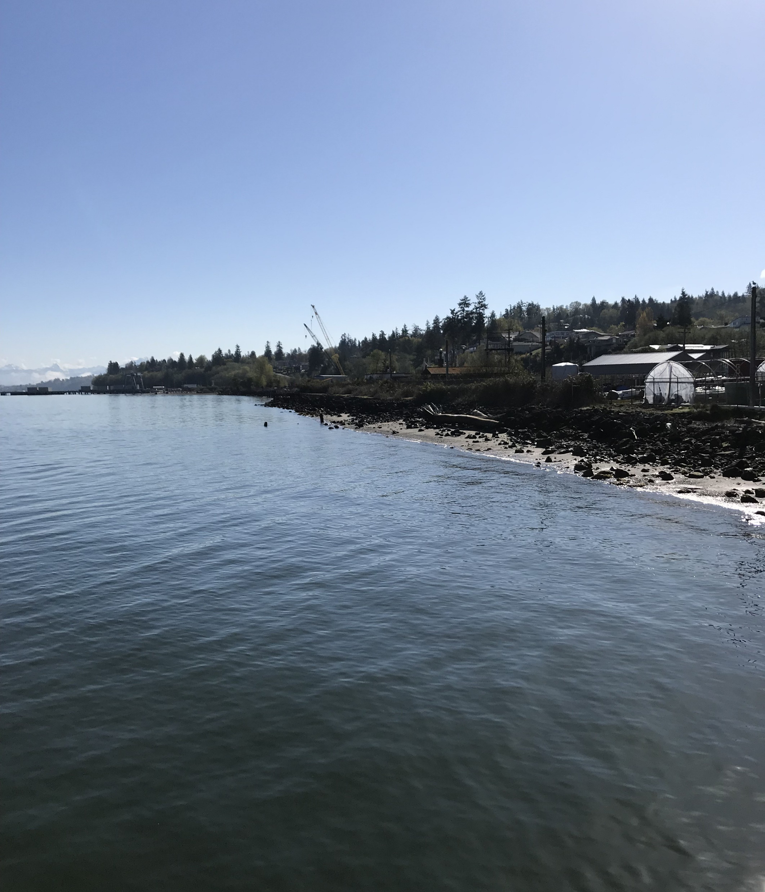
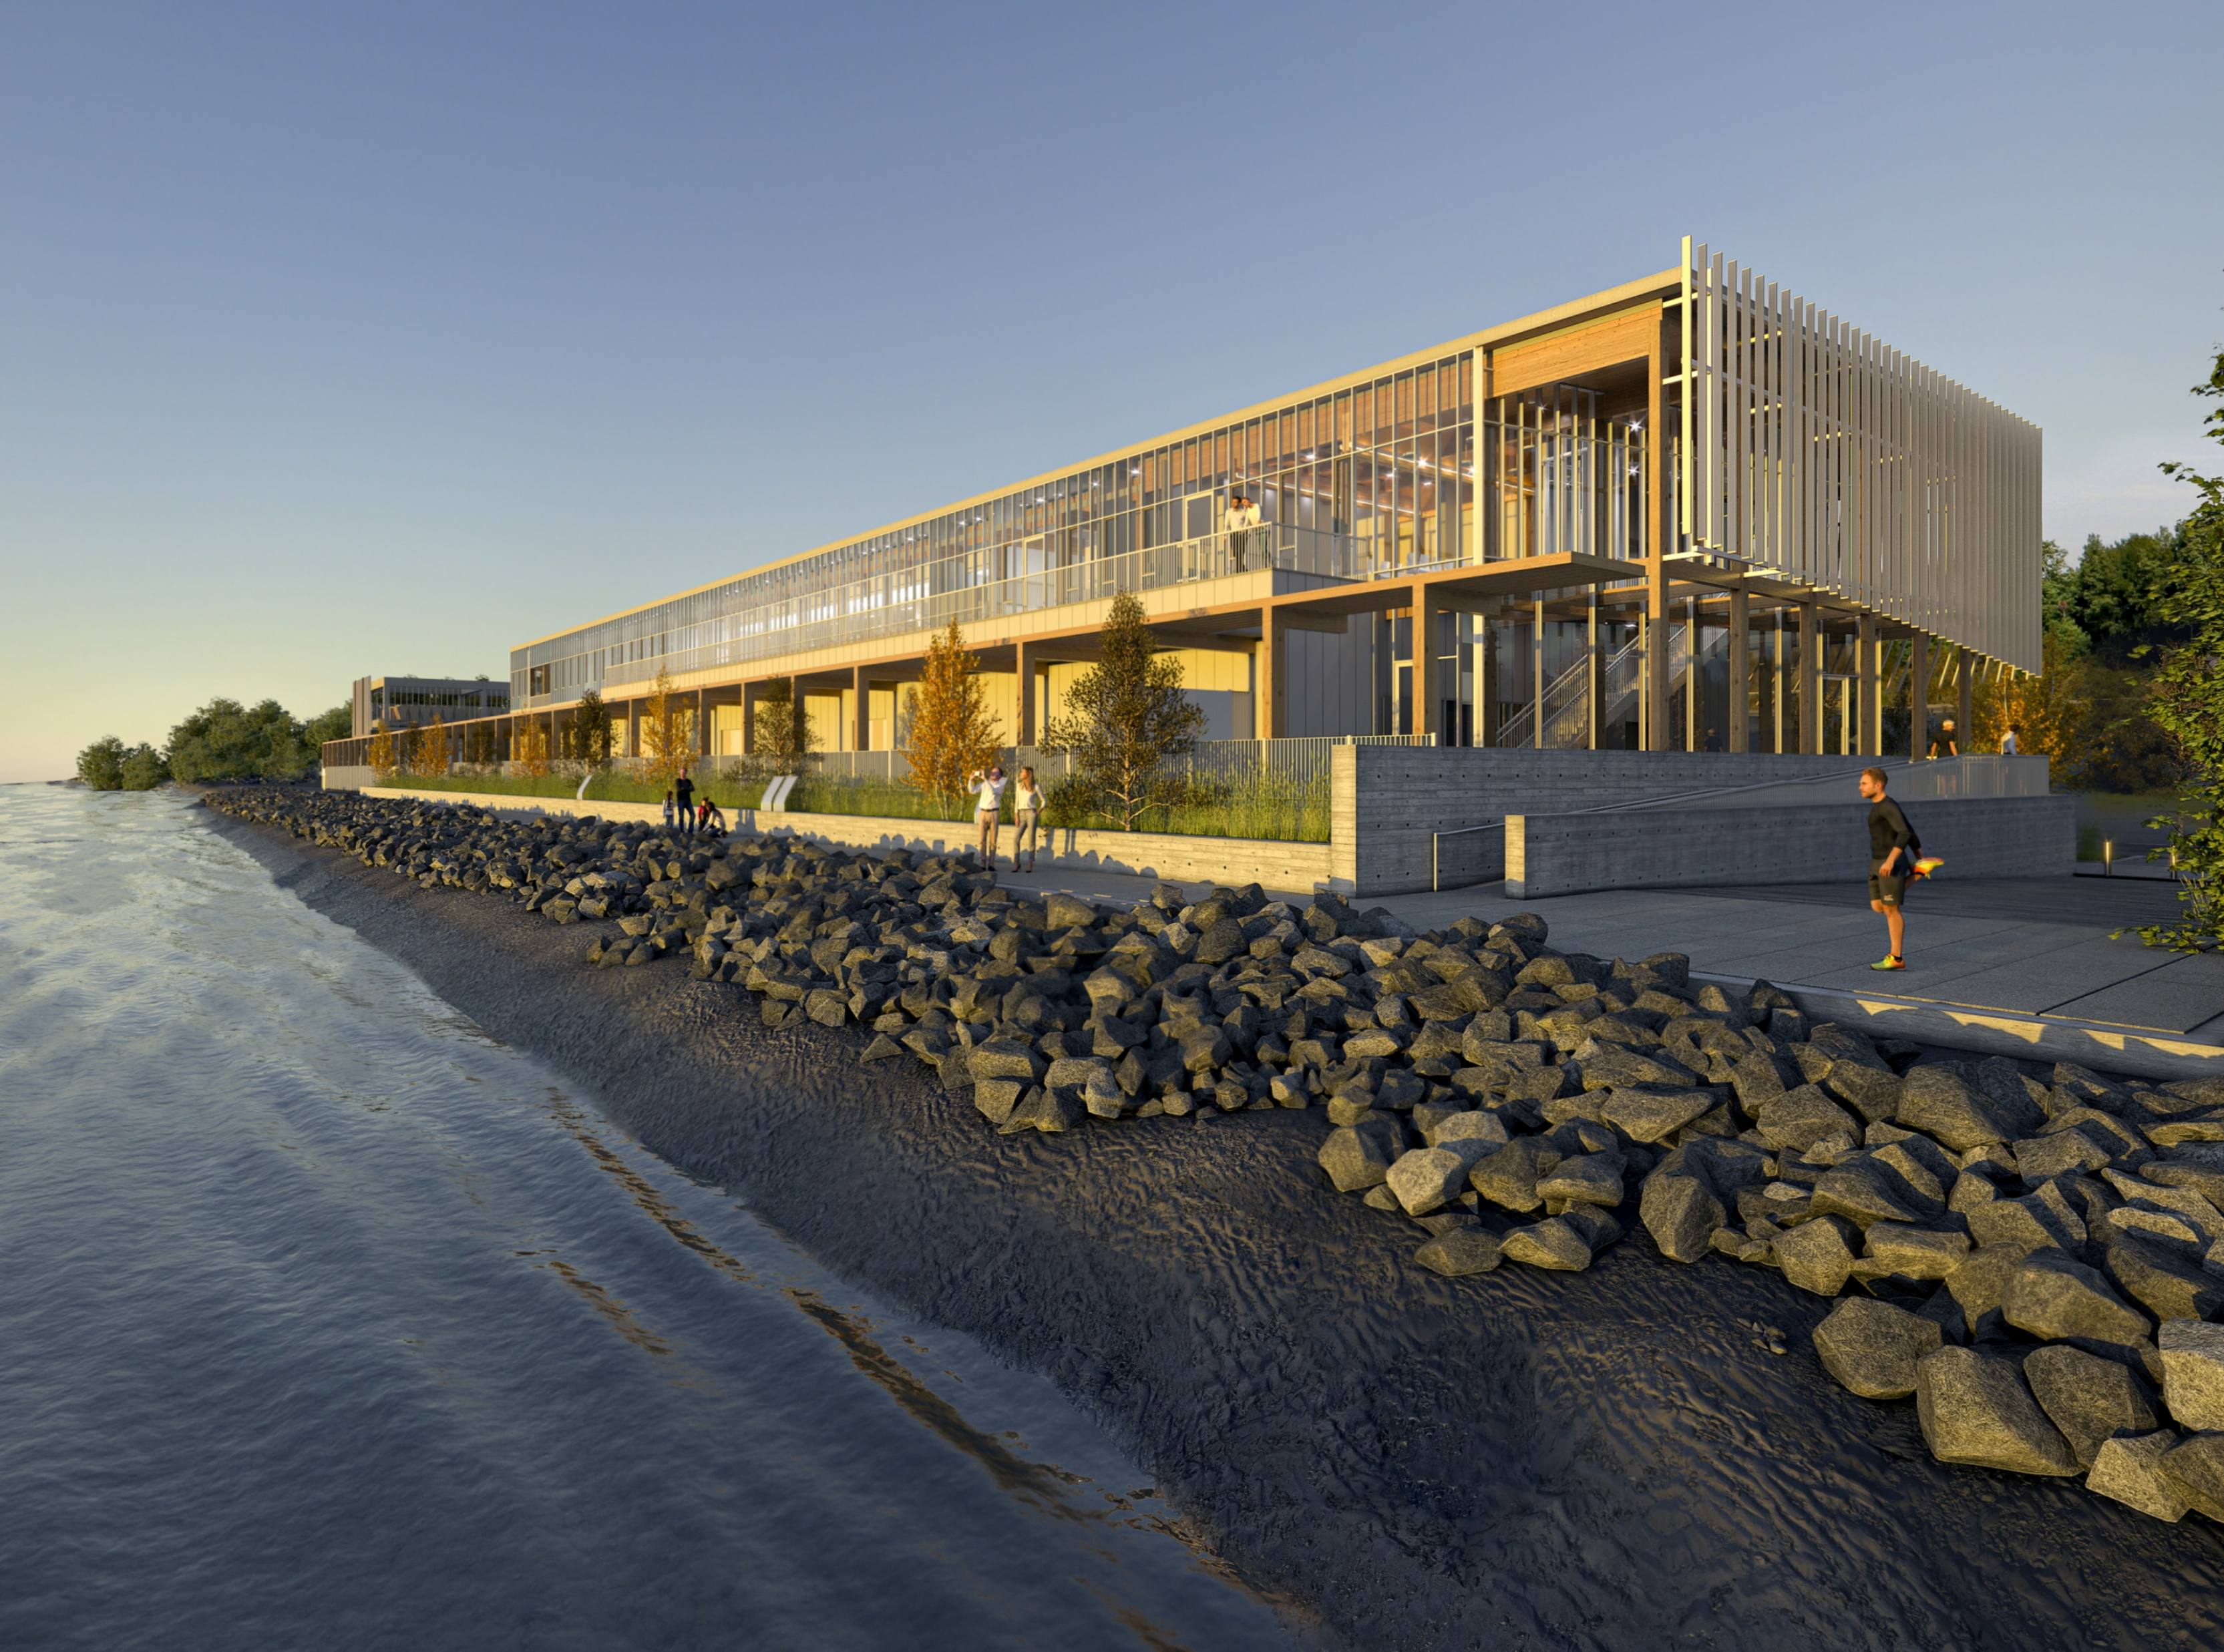
New NOAA Fisheries Research Facility
Northwest Fisheries Science Center - Mukilteo Research Station
Mukilteo, Washington

Slide 2
New NOAA Research Laboratory NWFSC Mukilteo Research Station (MRS)
Perform technical studies regarding seawater capture options
Evaluate, select and design optimal seawater capture/delivery system infrastructure
Incorporate advanced seawater filtration, treatment, pumping, and distribution
Develop precise titanium-based wet-lab seawater heating/cooling system
Develop optimal waste-water stream handling/treatment/disposal systems
Develop floor plans, elevations, sections and finishes for new NEFSC-MRS lab/office
Integrate latest laboratory design innovation/equipment for wet and dry lab areas
Perform detailed site environmental analysis/perform necessary Geotech onshore/offshore
Archeological site assessment relative to tribal history of site/surrounding area
Achieve LEED Silver level of energy efficiency and sustainability in design effort
Complete bridging documents/specifications to facilitate facility construction
Develop NOAA Master Building-Information-System Execution Plan for ALL projects
Develop all BIM Technical Requirements for NOAA use integrating O&M/BAS data into model
Integrate stakeholders from State and Federal Government, and City of Mukilteo into effort
Provide public comment meetings and reach out to Tribal interest for design input/feedback
Existing Shoreline

Slide 3
Existing Facility/Pier for Seawater Capture

Slide 4
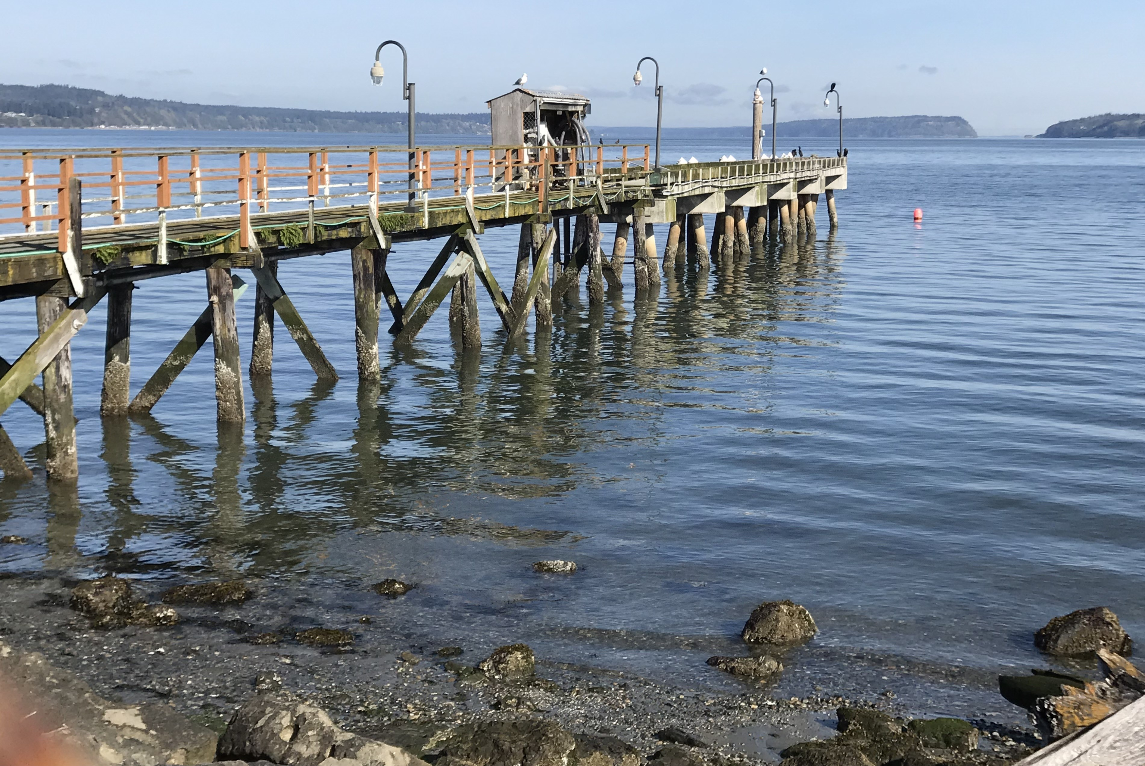
Seawater Capture Pier Removal

Slide 5
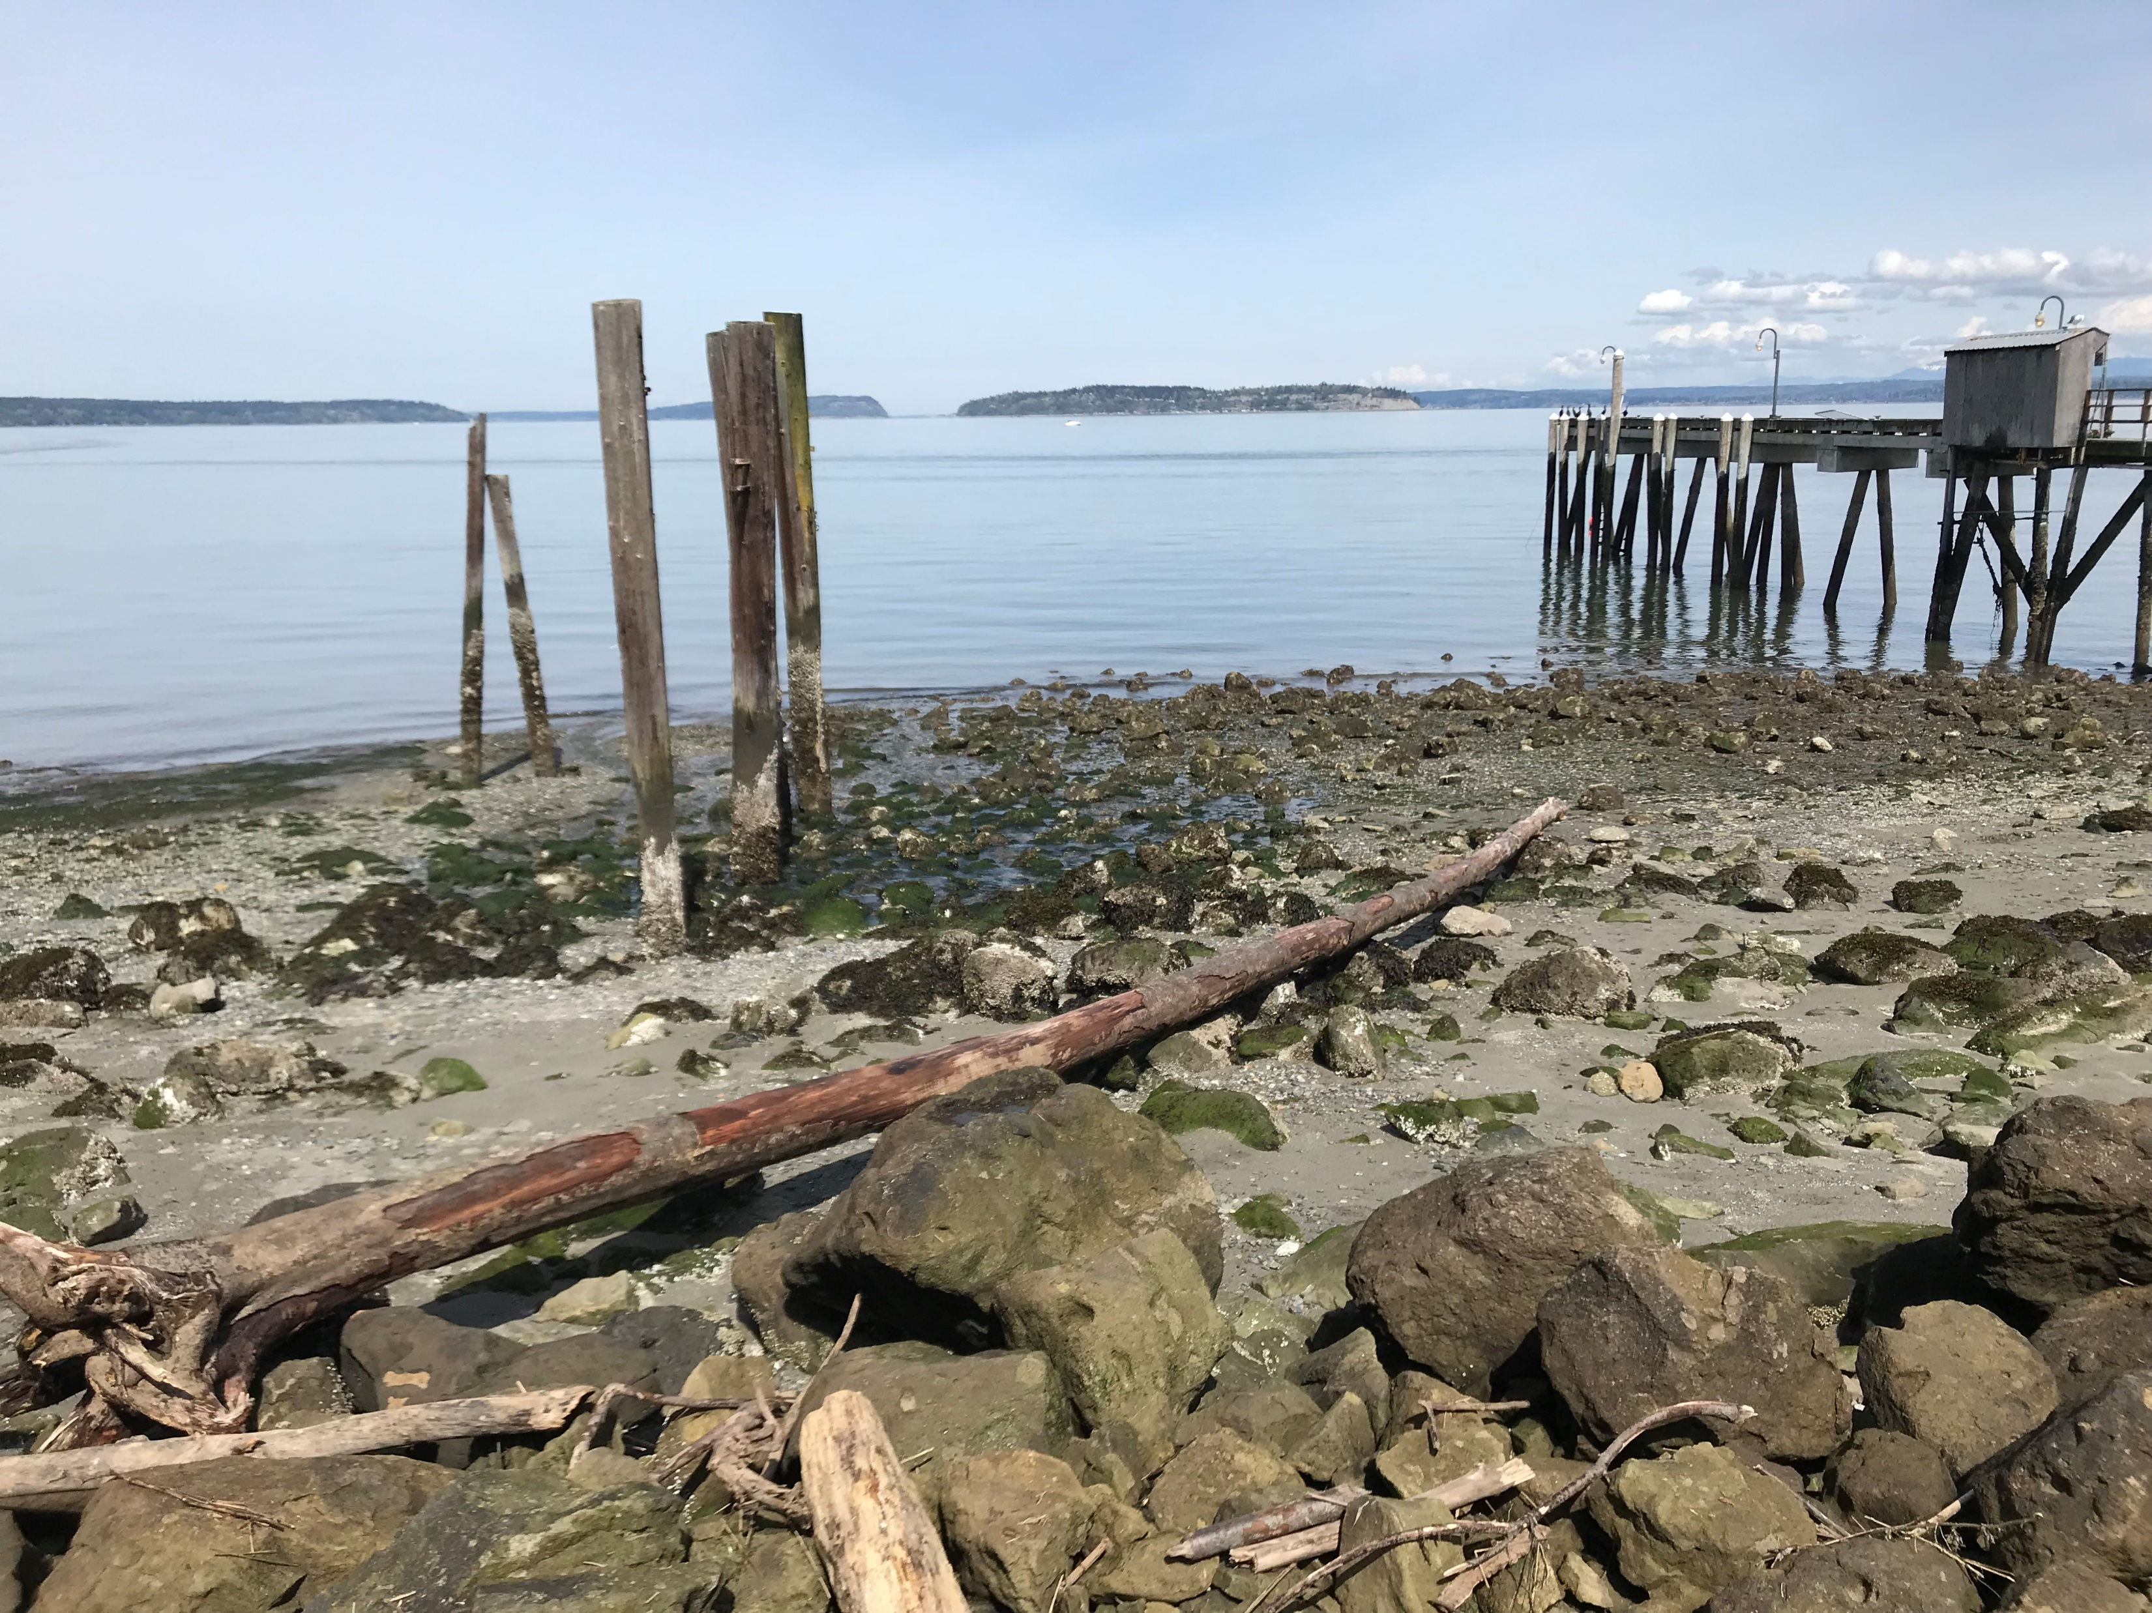
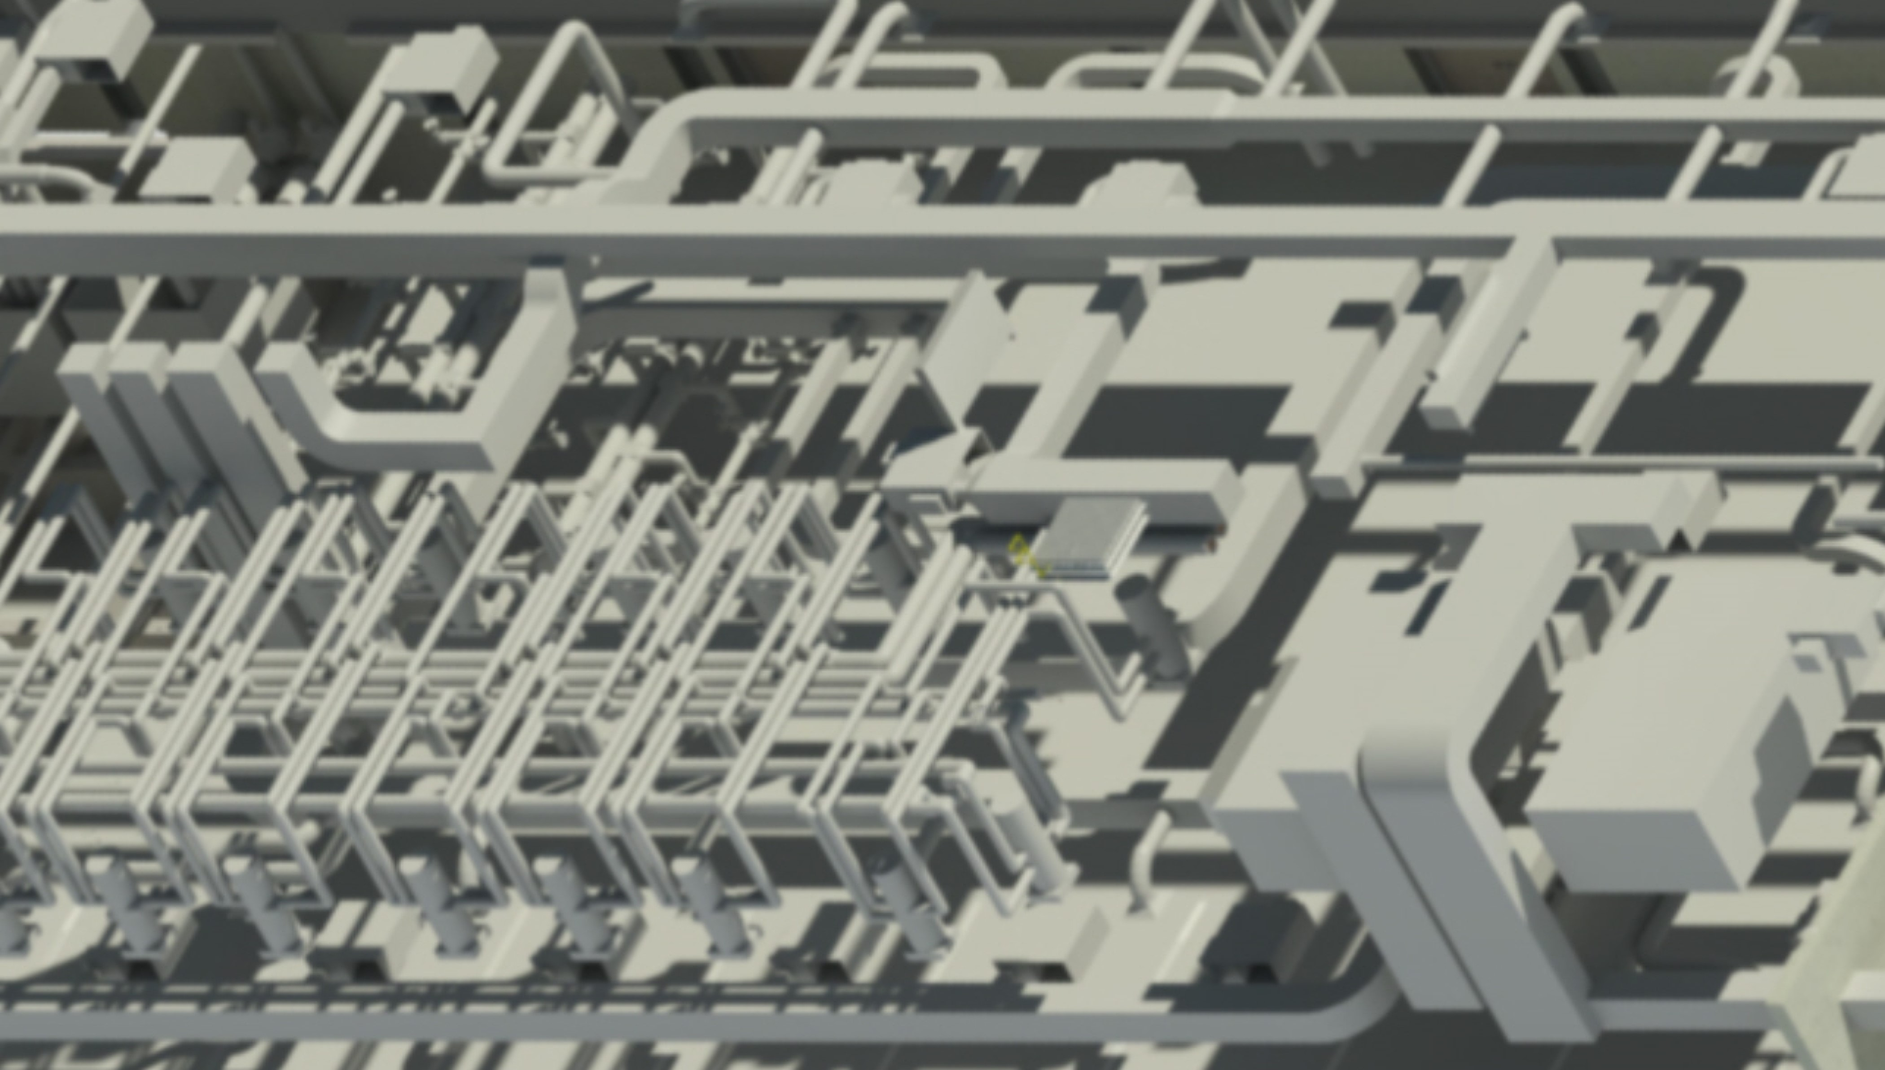
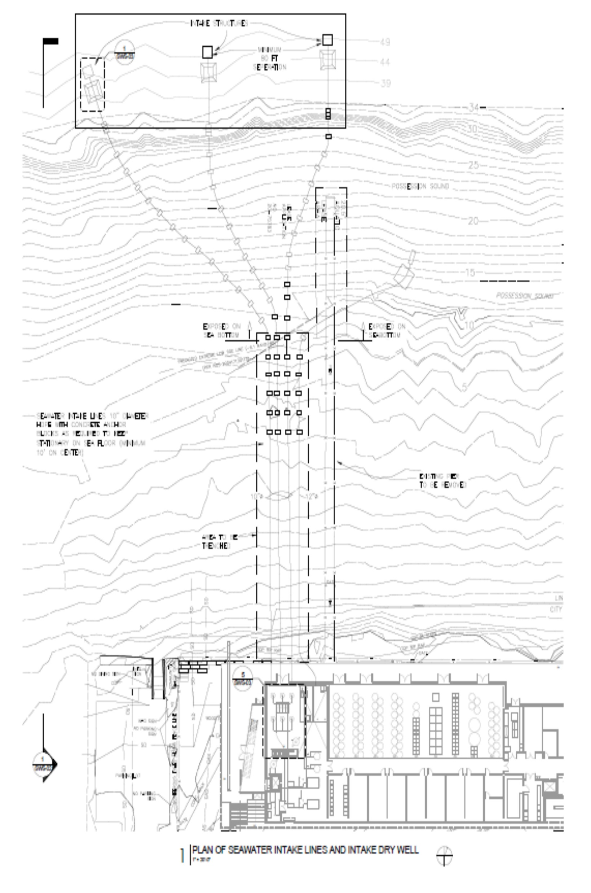
New Seawater Capture and Lab Water Distribution

Slide 6
BIM Model of Engineered Mechanical Infrastructure

Slide 7
Shoreline view of New Facility

Slide 8
