Slide 1
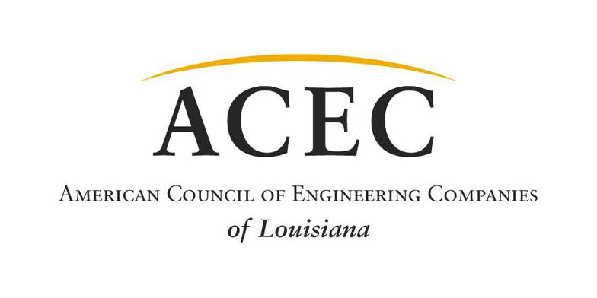
Firm Name:
HDR with key subconsultants COWI, GZA, and AECOM
Project Name: Governor Mario M. Cuomo Bridge
Project Location: Tarrytown, NY

Slide 2
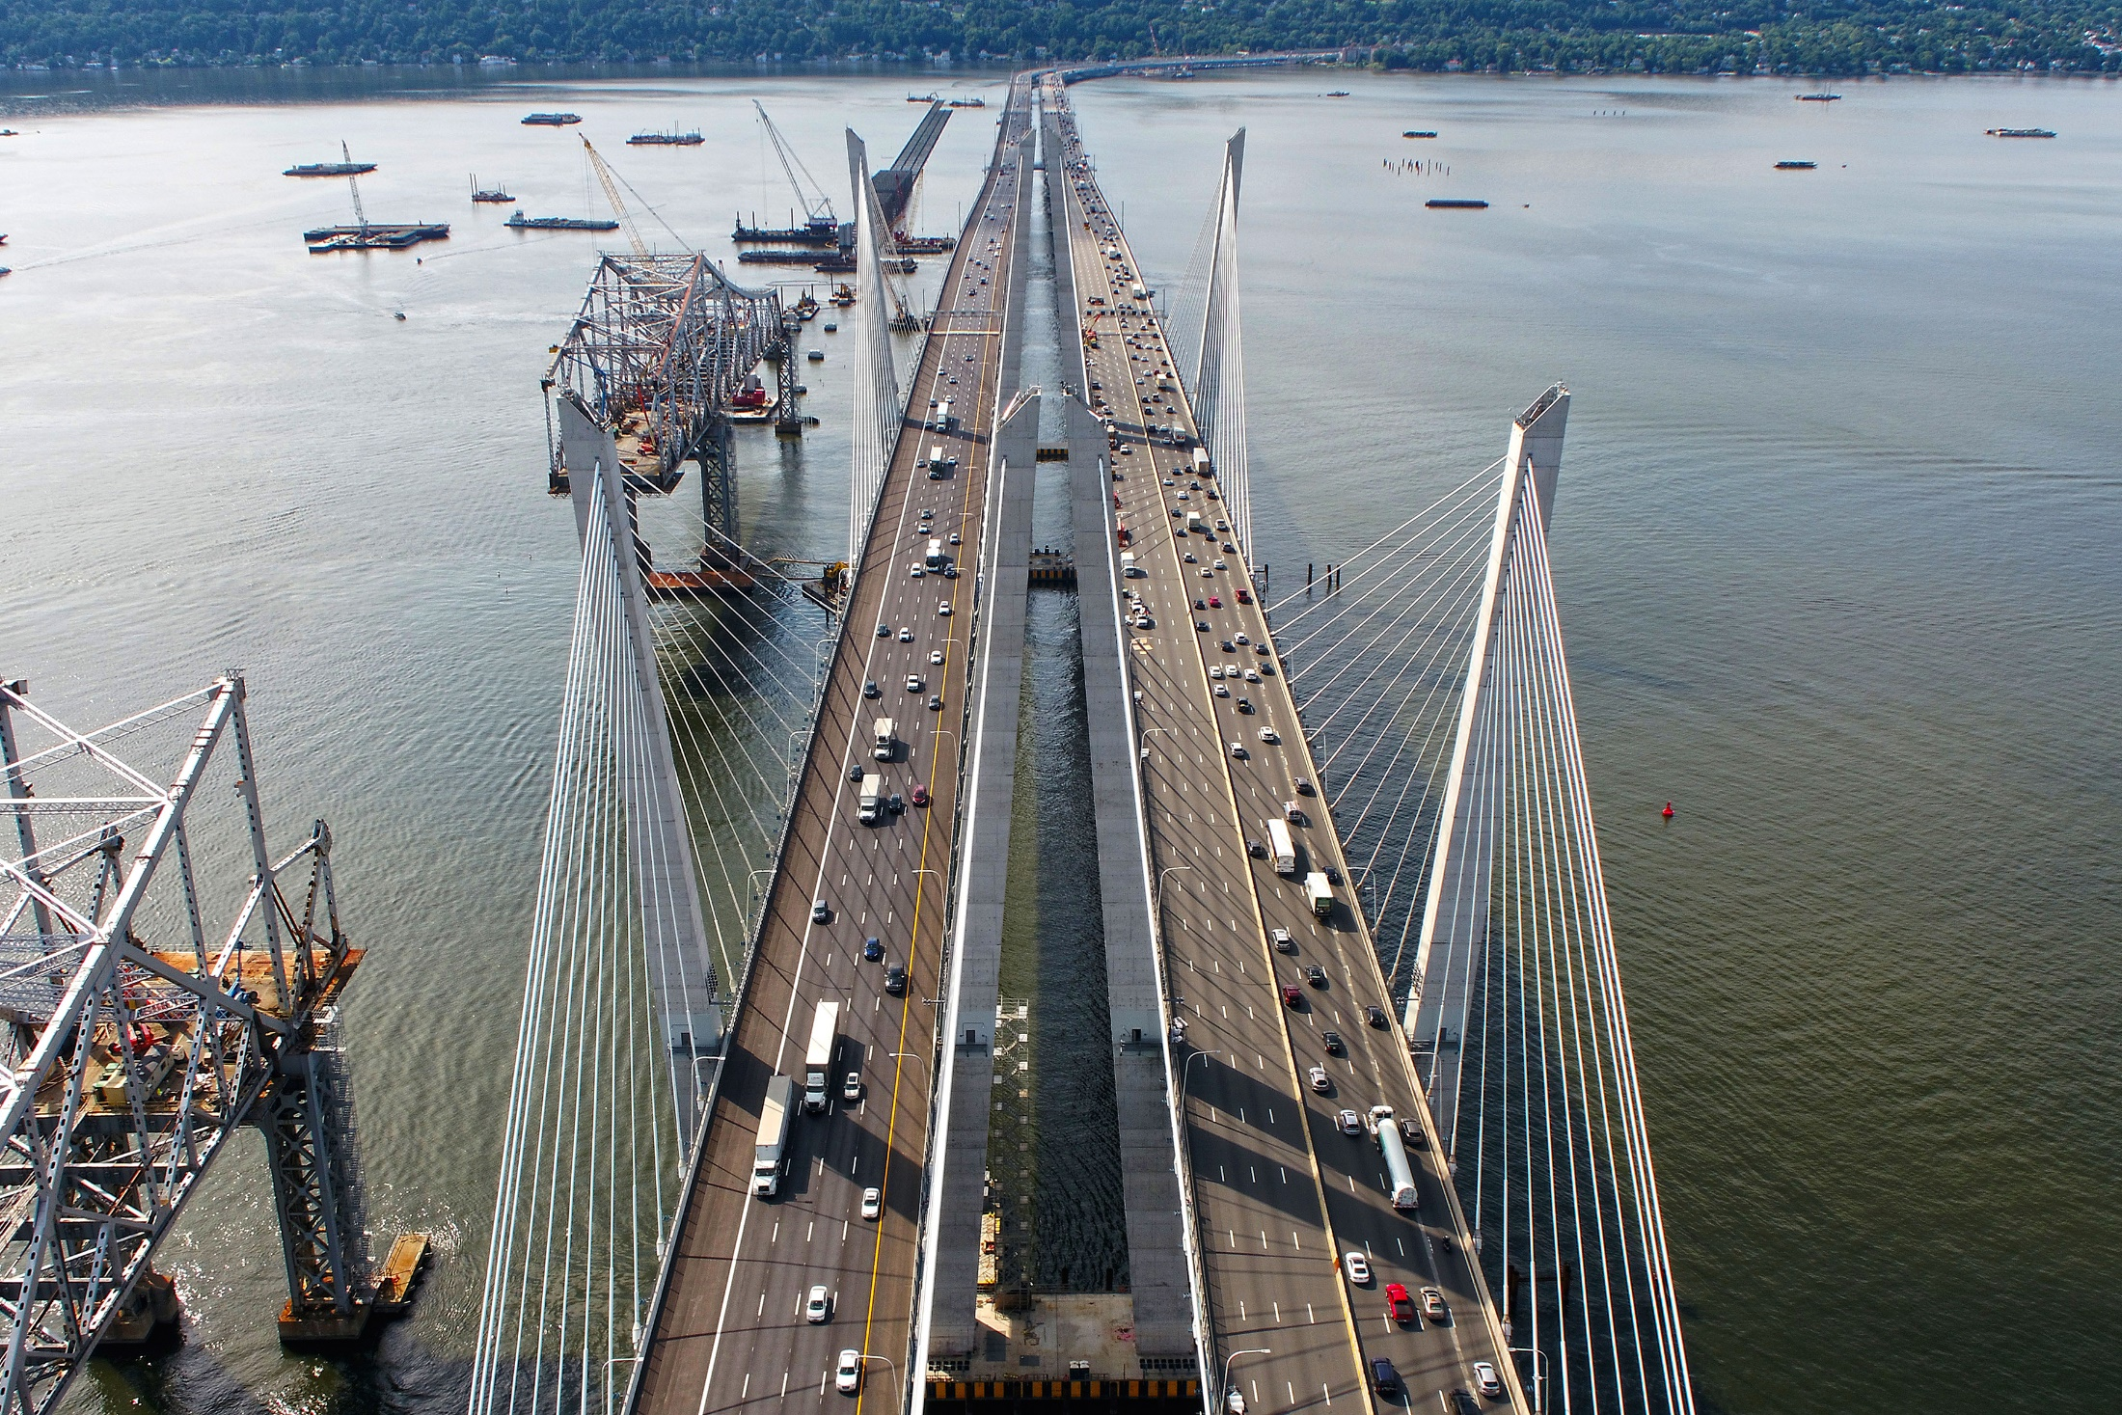

Slide 3
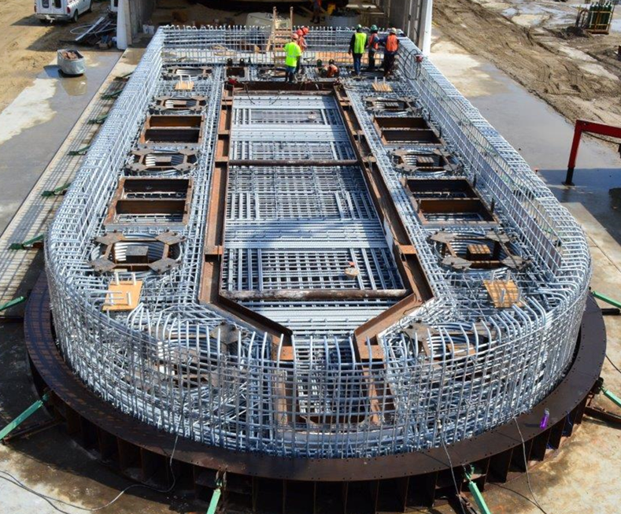

Slide 4
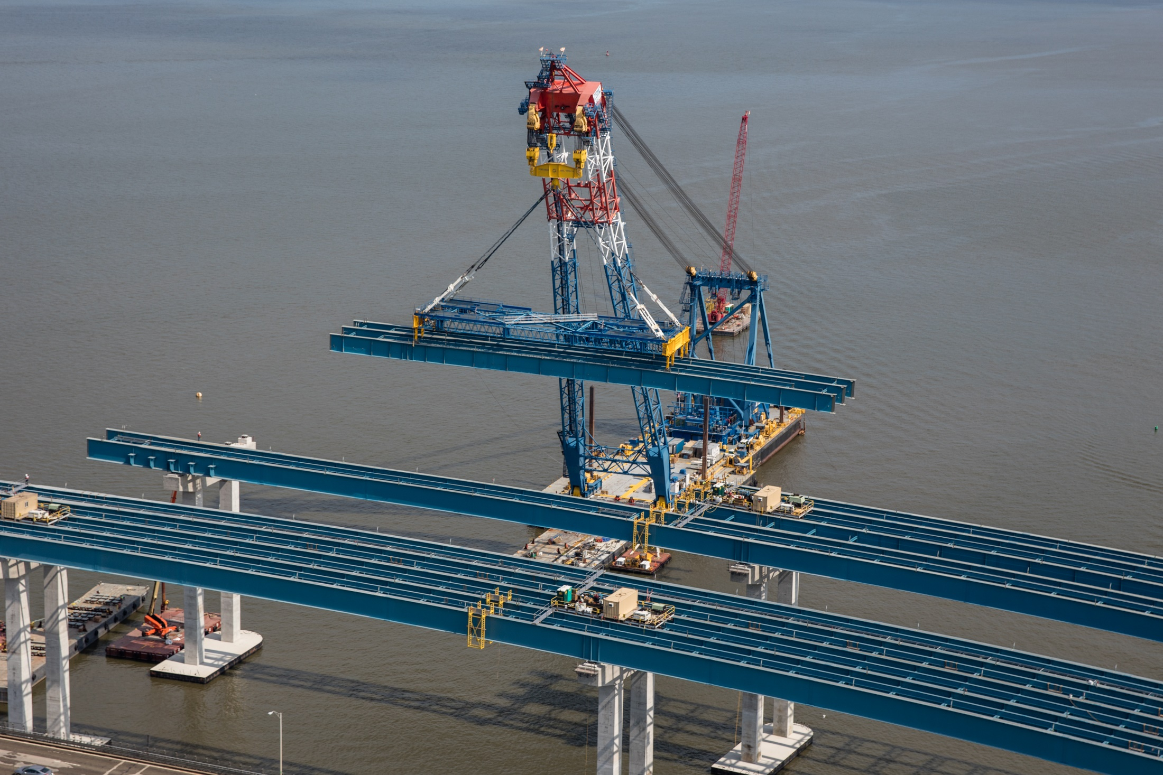

Slide 5
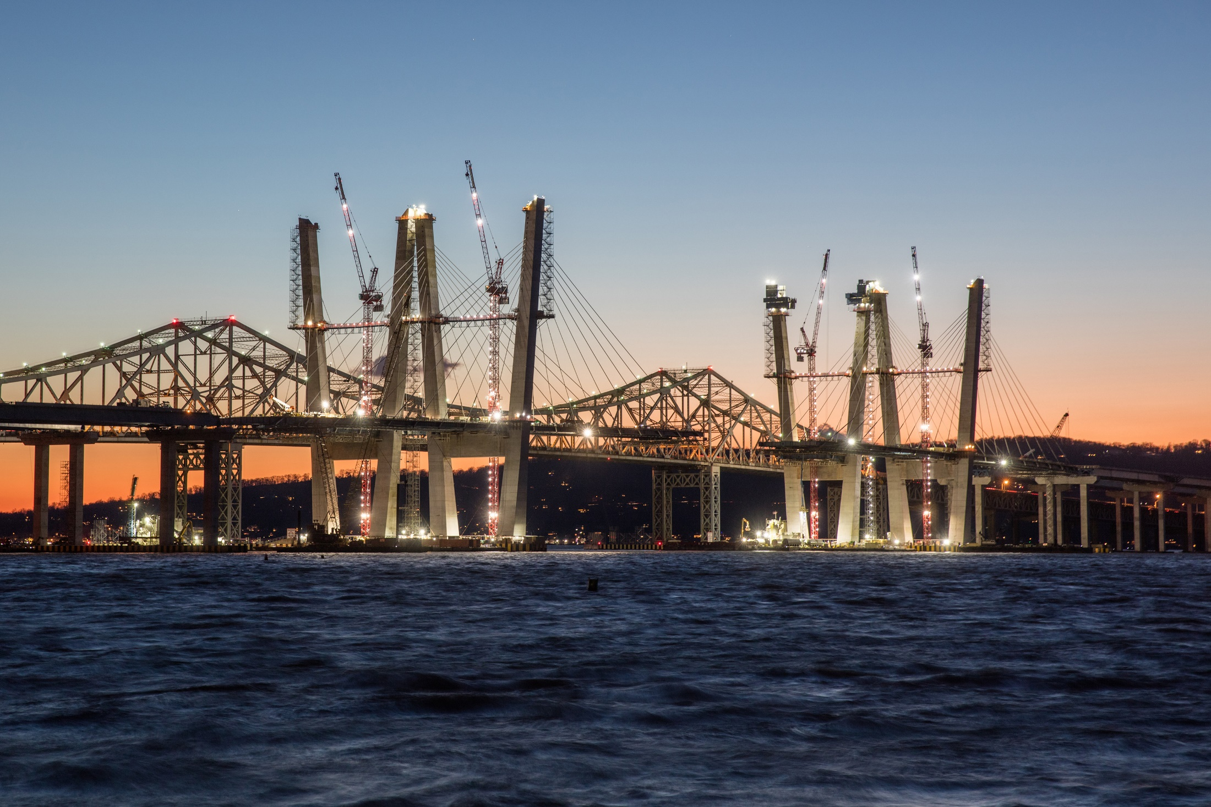

Slide 6
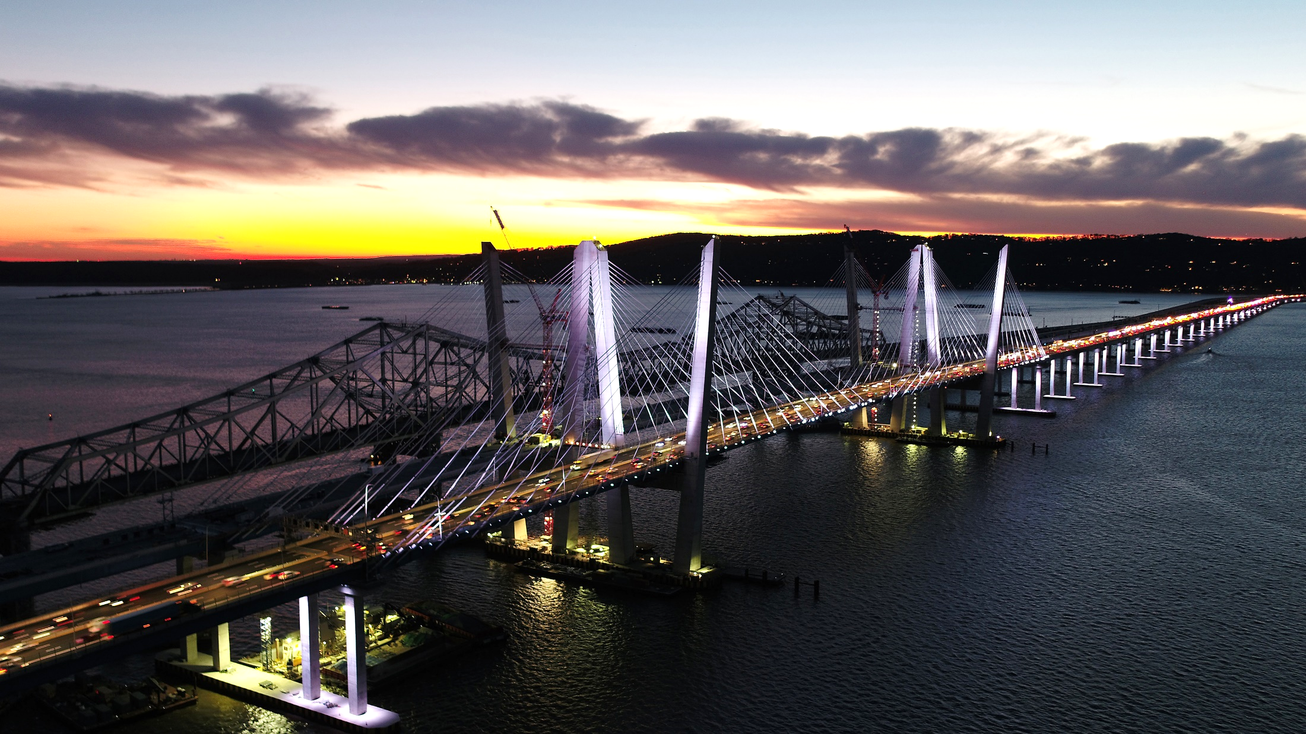

Slide 7
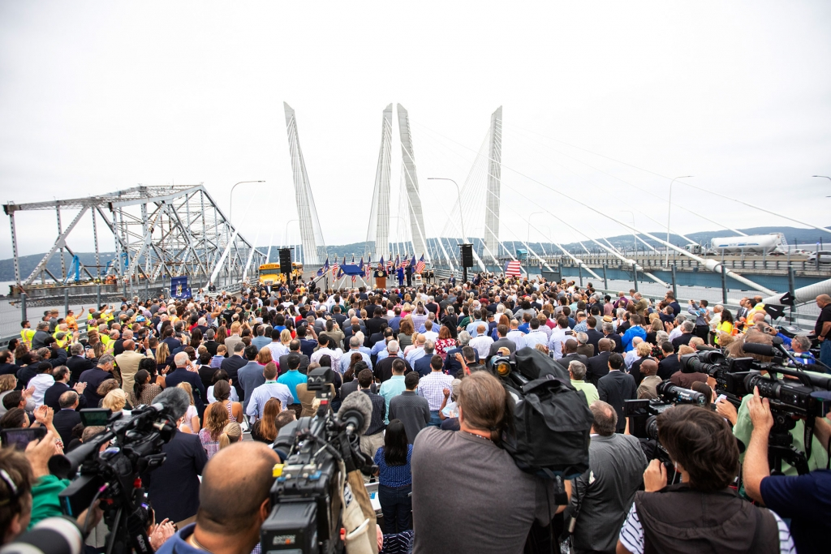

Slide 8
